Slide 1
Educational attitudes and aspirations over the business cycle
Mark Taylor and Tina Rampino
Institute for Social and Economic Research
University of Essex
Research funded by ESRC
Growing up in recession Britain
15/3/2013

Slide 2
Our question
To what extent are educational aspirations and attitudes of children affected by the macroeconomic climate?
Important because:
Large & persistent differences in educational attainment by socioeconomic status
Policy debate on how to reduce these differences recently focused on raising school performance among disadvantaged children through influencing their aspirations and attitudes
Policy interventions to change expectations and aspirations likely to be more cost-effective than directly improving cognitive development
Young people’s aspirations and attitudes are partly determined by perceived external opportunities.

Slide 3
Why are attitudes and aspirations important?
Positive relationship between children’s educational attitudes & aspirations & subsequent attainment & education-related behaviour
Positive attitudes and aspirations reduce participation in antisocial behaviours, & later life outcomes such as benefit receipt & early/lone parenthood among women.
Children from low income families have lower aspirations and attitudes than their peers from high income families
contributes to the persistence in advantage across generations

Slide 4
Mechanisms
Not clear how economic downturn will affect aspirations and attitudes
Positive effect if perceived to reduce opportunity costs of education (expected wages), or provides incentive to accumulate skills.
Negative effect if perceived to reduce expected future returns to investing in skills.
short-term costs of a recession will persist over time for a particular cohort as these translate into lower educational attainment and a reduction in life-chances.

Slide 5
Data
British Household Panel Survey/British Youth Panel 1994-2008 & Understanding Society data 2010 (BHPS sample)
Approx 1,000 11-15 year olds interviewed each year
Rotating panel:
core group remains within sample for maximum of five years
each year 16 yr olds move to adult survey and replaced by new cohort of 11 yr olds.
Collect info on e.g. use of leisure time, health, well-being, relationships with family and peers
Match child level data to data on other hhold members
Capture business cycle using regional annual gender-specific unemployment rate among 16-24 yr olds from Labour Force Survey.

Slide 6
Measures of attitudes/aspirations
“How much does it mean to you to do well at school? Does it mean very little, a bit, quite a lot, a great deal?”
“How important do you think it is for you to get your GCSE exams? Is it not at all important, not very important, important, very important?”
“Do you want to leave school when you are 16, or do you plan to go on to sixth form or college?”
“Would you like to go on to do further full-time education at a college or University after you finish school?”
Focus on positive attitudes/aspirations
School means a great deal
GCSEs very important
Plans to remain in education at 16
Wants to go to university

Slide 7
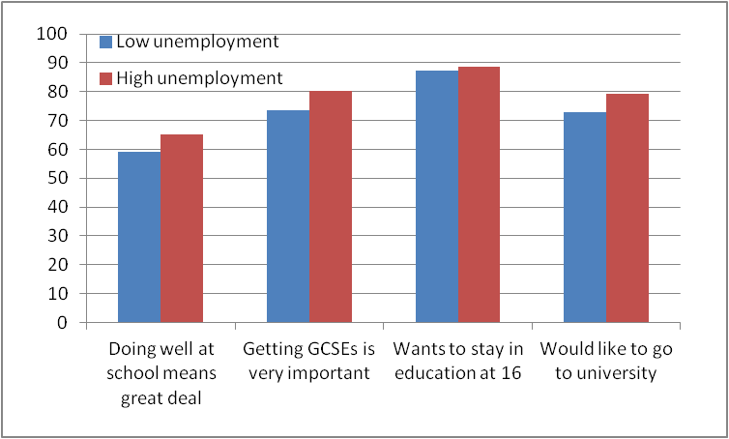
Proportions of children with positive attitudes and aspirations by regional unemployment

Slide 8
First findings:
Evidence that attitudes & aspirations counter-cyclical
Children view school more positively when unemployment relatively high and opportunity costs of education low.
May reflect other differences between children/hholds across low & high unemployment regions & over time.
Estimate models that allow for differences between children in demographics, hhold charactistics and parental background.
Illustrate findings by presenting probability of positive attitudes/aspirations when unemployment low (10%) and high (20%)

Slide 9
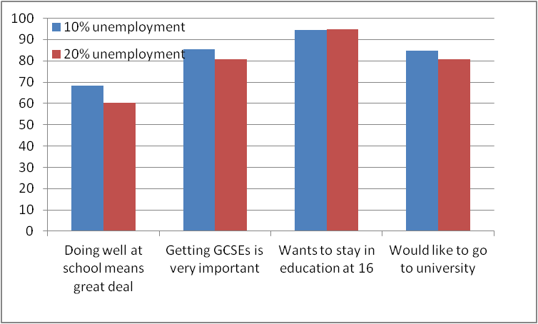
Impact of regional unemployment rates on probability of having positive attitudes and aspirations

Slide 10
Second findings
All else equal, a 10 percentage point increase in youth unemployment (from 10% to 20%) associated with more positive attitudes to schooling
Increases probability that doing well at school means a great deal from 61% to 67%
Increases probability that GCSEs very important from 81% to 86%.
Has little impact on aspirations for post-compulsory education or aspirations for university

Slide 11
Second findings (cont.)
Children’s educational attitudes vary counter-cyclically
Sizes of effects small relative to other factors (e.g. age, gender, parental education and employment, parental migration status)
BUT such factors relatively fixed and cannot be influenced by policy!!
So far effects averaged across all children – sizes of effects may vary across kids from different backgrounds
We find they do – particularly by parental education levels and parental attitudes to education.

Slide 12
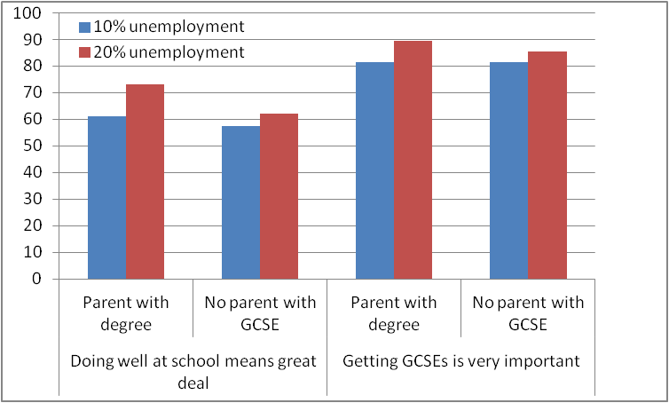
Differences by parental education in impact of increasing unemployment on probability of having positive attitudes to schooling

Slide 13
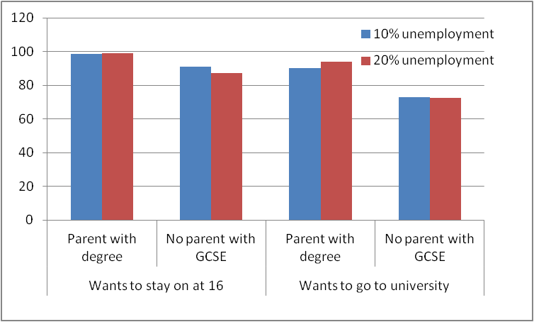
Differences by parental education in impact of increasing unemployment on having positive educational aspirations

Slide 14
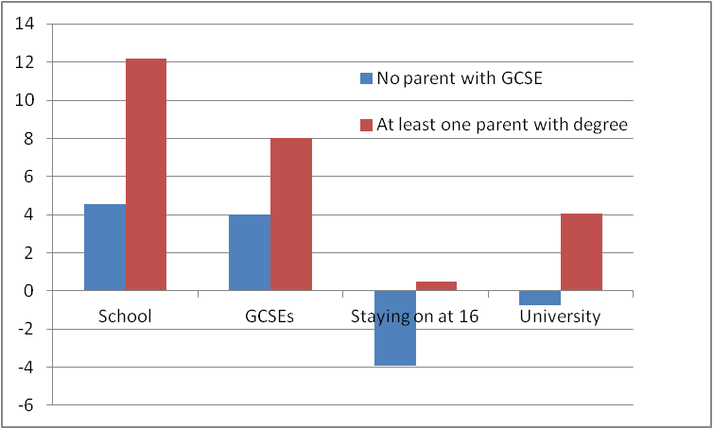
Effect of a 10ppoint increase in youth unemployment rate on holding positive educational attitudes and aspirations by parental education level

Slide 15
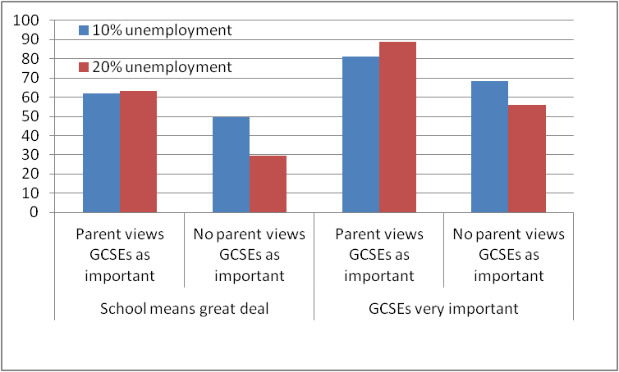
Differences by parental attitudes to education in impact of increasing unemployment on attitudes

Slide 16
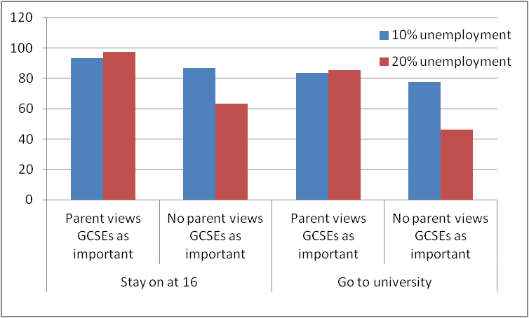
Differences by parental attitudes to education in impact of increasing unemployment on aspirations

Slide 17
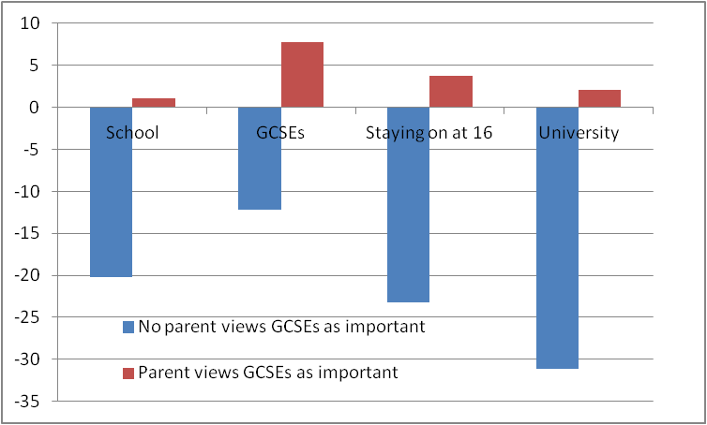
Effect of a 10ppoint increase in youth unemployment rate on holding positive educational attitudes and aspirations by parental attitudes to education

Slide 18
Summary/conclusions
Educational aspirations & attitudes of 11-15 year olds are counter-cyclical – sizes relatively small.
Impacts of unemp rates on children’s attitudes & aspirations differ by parental educ. & attitudes to educ.
Children with high educated parents more positively affected by downturns than children with less educated parents.
Unemployment rates reduce aspirations among 11-15 year olds with low educated parents; no impact among children with high educated parents.
Educational attitudes/aspirations of children with parents who hold less positive attitudes to education reduced when unemp high; those of children with parents who hold positive attitudes to education unaffected.
NOTE: effects not driven by income differences.

Slide 19
Policy implications
Without intervention, during downturns motivation, behaviour & attainment of children with low educated parents falls behind those of children with highly educated parents.
For cohort of children proceeding through secondary school during downturns, attainment & life-chances of those with low educated parents falls behind those with high educated parents. Reduces social mobility.
Suggests need to target policies aimed at maintaining positive educational attitudes and aspirations at children & parents in areas & schools where high proportion of population have low qualifications/negative attitudes.

