Slide 1


Using panel data to estimate the impact of party leaders in the 2015 election
Jonathan Mellon and Geoffrey Evans
Nuffield College
Essex, 20th May 2016
www.britishelectionstudy.com

Slide 2
  Why focus on leaders?
A key element of campaign coverage
  The personalisation of politics
  Most visible symbol of a party
  Very common belief that choosing the right leader is the key to a party’s success or failure
Some academic scepticism about the importance of leaders:
  Party support influences judgements
  Leaders proxy for policy and party performance
  Big question is how to measure a “clean” effect
Notes:
Typical political science approach
A statistical association between approving of a leader and vote intention, net of, e.g. partisanship, issue proximity

Slide 3
Averages can be misleading
Journalists regularly discuss the importance of leaders
  Typically on the basis of percentage approval ratings
  Academic studies have also tended to look cross-sectionally (Aarts, Blais and Schmitt, 2011)
But...
  A leader can have stable or even falling ratings while still helping their party
  A leader that helpings their party keep existing voters may not help gain votes

Slide 4
The evidence base
Waves 1 – 6 of the BES panel survey, February 2014 – May/ June2015, N=c.22,000 respondents*
“How much do you like or dislike each of the following party leaders?” (response: 0 – 10 scale)
“Thinking overall about how the party leaders are performing during the election campaign, which party leader do you think is performing best so far?” (response: choose one)
*excluding Scotland
Notes:
We exclude Scotland because
Explain BES
Sampling
Weighting
Clarke correlations similar
Most problematic for studying non-voting but less problems for studying vote switching
Face-to-face probability survey is necessary in order to study non-voting effectively, make population estimates and calibrate the Internet panel data
Retention rates

Slide 5
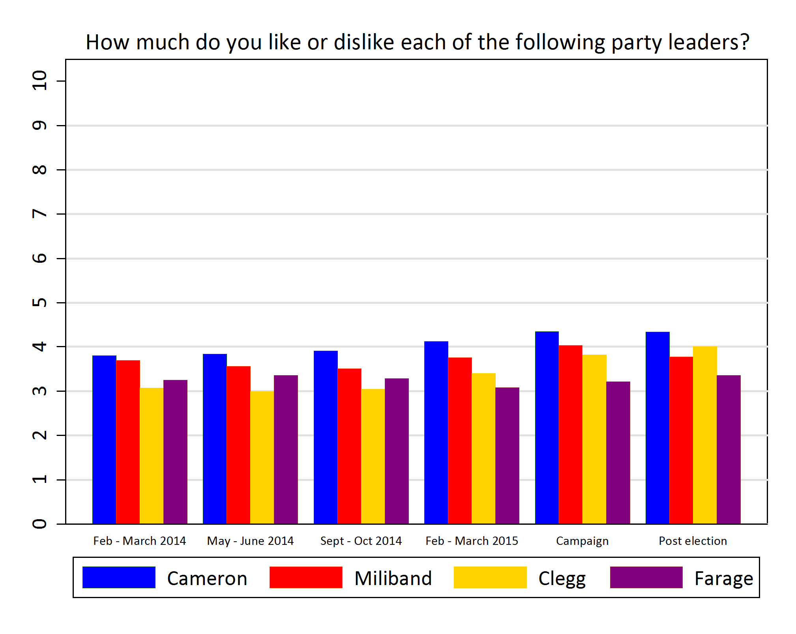
Leadership evaluations over 15 months
Notes:
Leader evaluations stable across six waves & 16 months
Small improvements for Cameron, Clegg & Miliband (post-election dip for Miliband)
Mobilizing supporters during the campaign

Slide 6
The remarkable stability of voters’ leader evaluations
Leader like correlations
Leader | W1 to W4 | W4 to W6 | W1 to W6
Cameron | 0.85 | 0.88 | 0.83
Miliband | 0.80 | 0.81 | 0.75
Clegg | 0.73 | 0.73 | 0.65
Farage | 0.71 | 0.82 | 0.68

Slide 7
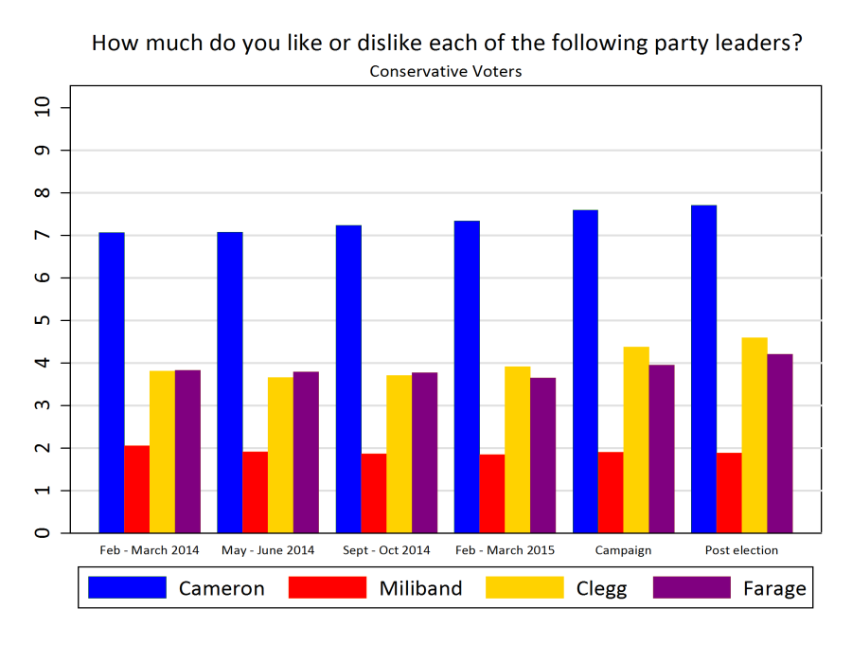
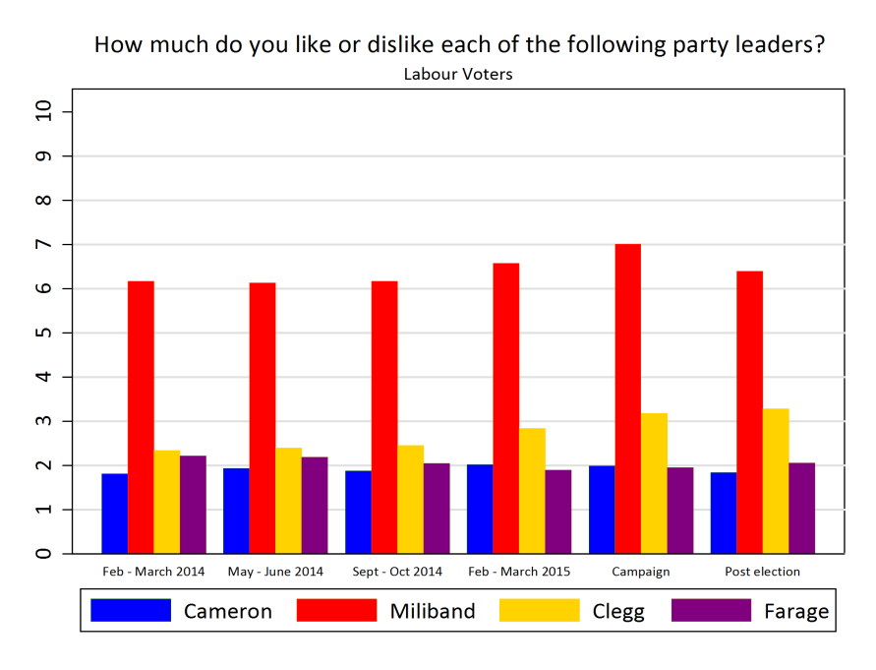
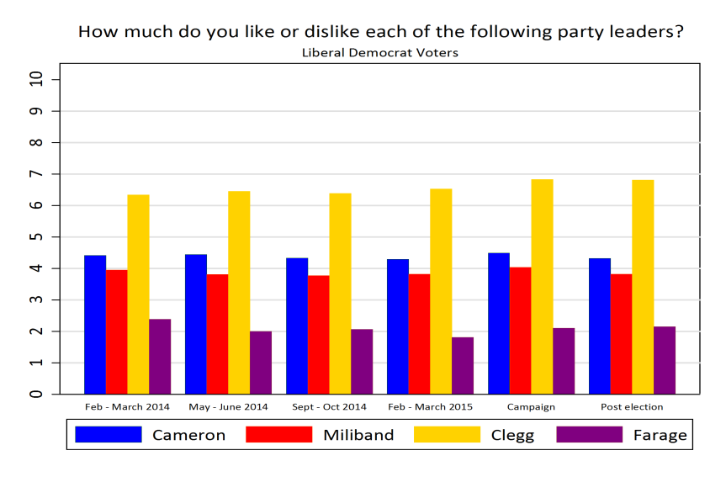
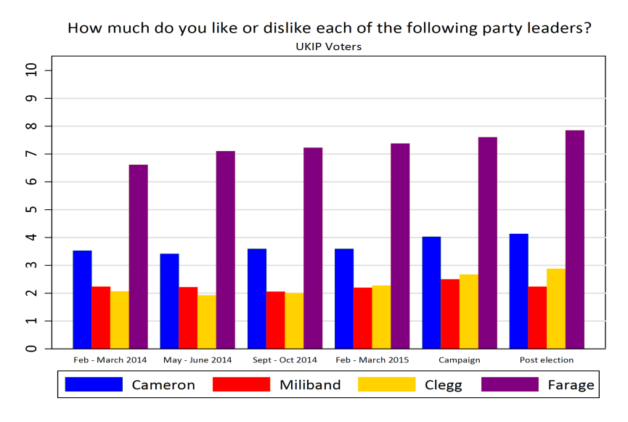
How informative are these evaluations?
Notes:
Among partisans:
Small aggregate improvements in leader approval (post-election dip for miliband)
Large partisan biases; but less so for the Lib-Dems
Slightly higher ratings by partisans for Cameron & Farage compared to Miliband & Clegg

Slide 8
Challenges in modelling leadership
Leaders may have different effects on recruitment to retention
  Estimate switching to and switching from separately
Endogeneity of leadership evaluations to party choice
  Looking at party switching rather than cross-sectionally
  Looking at changes in leadership evaluations
  Test the robustness of our leadership estimates to the inclusion of many other (also possibly endogenous) controls
Estimating the effect of vote at t₁ on vote at t₂
  Run a separate model for each group of voters at t₁

Slide 9
Our approach
Effects of changes in approval ratings on changes in party choice:
  recruitment (do they attract support from other parties?)
  retention (do they retain their own?)
  maximal (no controls) & minimal (with controls) net effects

Slide 10
How we estimate effects….
Separately model each flow from origin to destination (without/with controls)
Counter-factual probabilities of switching holding leader constant compared to actual probabilities = estimate of per cent effect
Same procedure applied to a leader’s destination party to estimate recruitment effects
Net effect = recruit/retained divided by initial share of vote
  Example: model of wave 4 choices for Conservative wave 1 voters: Cameron’s effects = ‘retention’, other leaders are ‘pull’

Slide 11
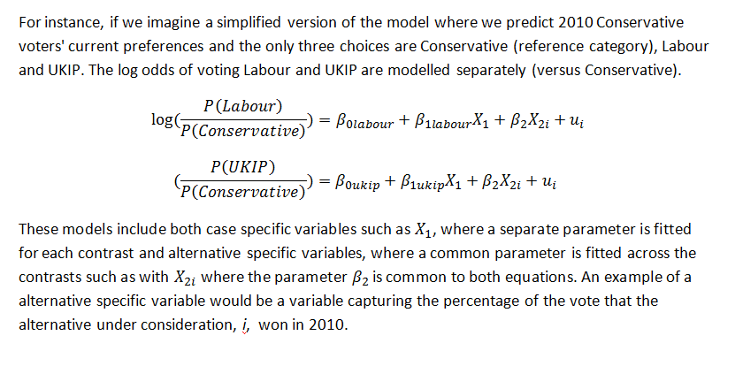
Model specification
McFadden choice models that allow coefficients to be shared across contrasts or only included for certain contrasts
A separate model is run for each set of voters at t₁
log

Slide 12
Example of a change-on-change model: Conservative origins (McFadden choice models) w4-w6 coefficients
 | Labour | Lib Dem | UKIP | Other | Don't know
Miliband (W4-W6 change) | 0.30**
Farage (W4-W6 change) |  |  | 0.26***
Clegg (W4-W6 change) |  | 0.00
Conservative best on MII (W4-W6 change) | -1.27** | -1.17*** | -1.21*** | -1.51* | -1.03*
Party ID strength (W4-W6 change) | -0.12 | 0.42* | 0.29 | -0.03 | -0.87
Cameron (W4-W6 change) | -0.63*** | -0.12 | -0.34*** | -0.17 | -0.41
Party ID Conservatives (W4-W6 change) | -0.5 | -0.32 | -0.06 | -1.25 | -0.19
Constant | -3.26*** | -2.36*** | -2.86*** | -3.76* | -5.66***
Parameters are logistic regression coefficients, the base category is Conservative * p<0.05, ** p<0.01, *** p<0.001
Alternative specific predictor for Most important issue in wave 4 not shown

Slide 13
The questions:
Who helped their party win votes?
  By pulling in recruits
  By retaining supporters
  Over the long pre-campaign (February 14- to March 15)
  Over the formal campaign?
  Over the whole period (February 14-May 15)

Slide 14
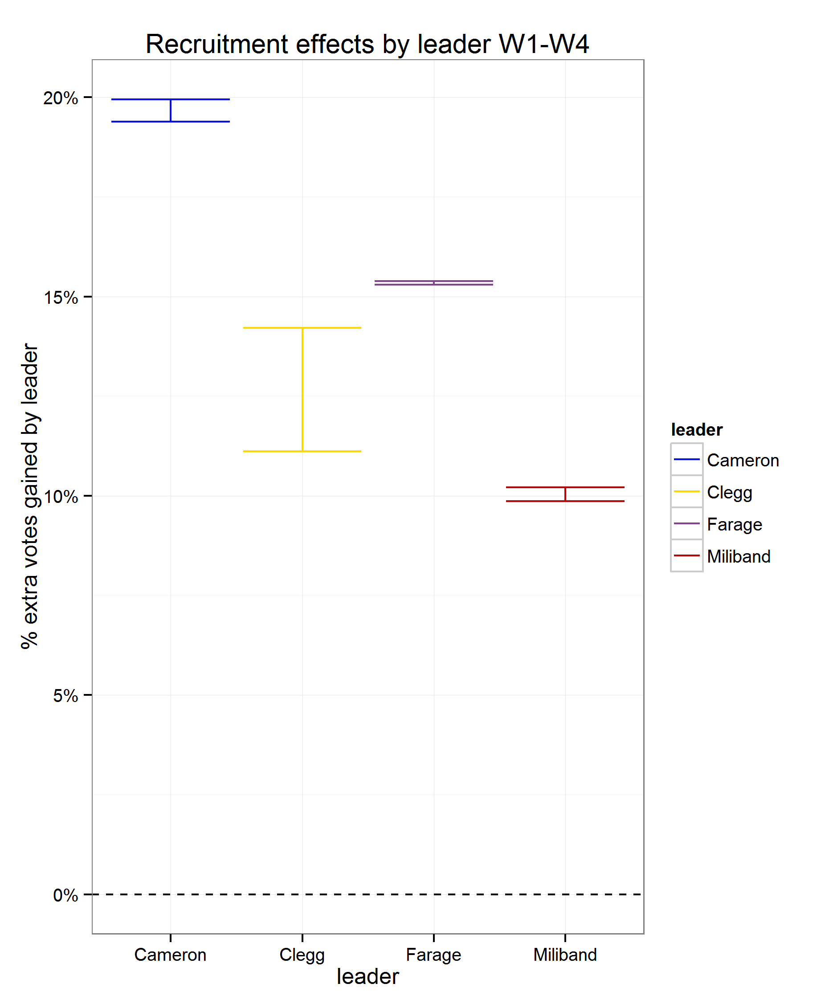
Leaders’ impact on vote switching Feb 2014 to Feb 2015
Notes:
Note that the wide band on the loss effects for Cameron is partly because the Conservatives didn’t lose many votes across that period (they retained 88% of their w1 voters). 5% of 12% of 27% is not that many votes.

Slide 15
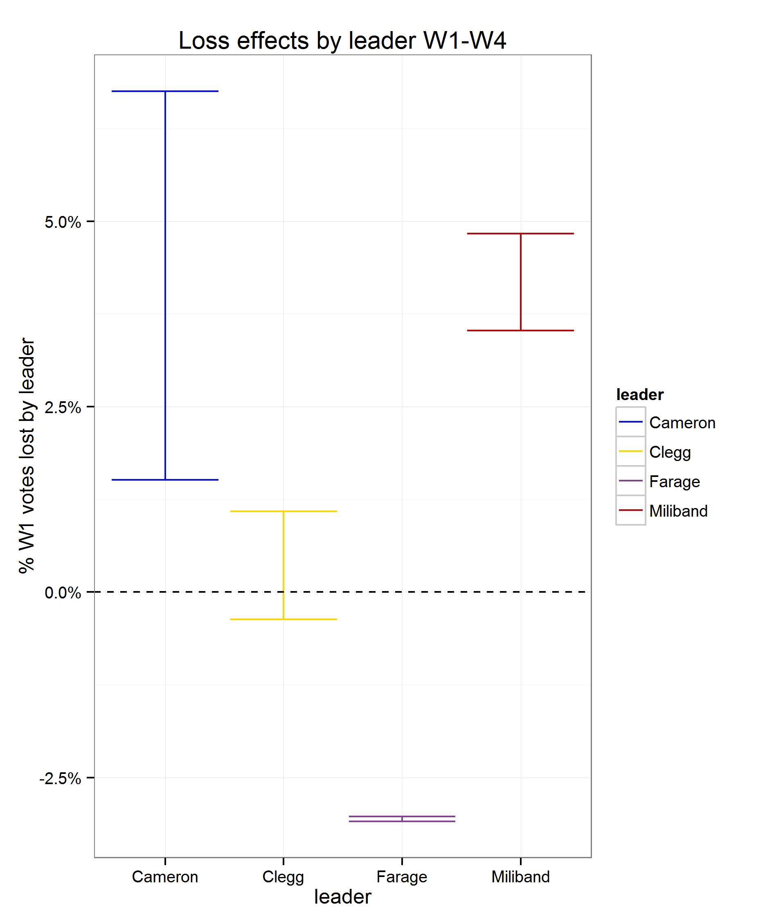
Leaders’ impact on vote switching Feb 2014 to Feb 2015
Notes:
Note that the wide band on the loss effects for Cameron is partly because the Conservatives didn’t lose many votes across that period (they retained 88% of their w1 voters). 5% of 12% of 27% is not that many votes.

Slide 16
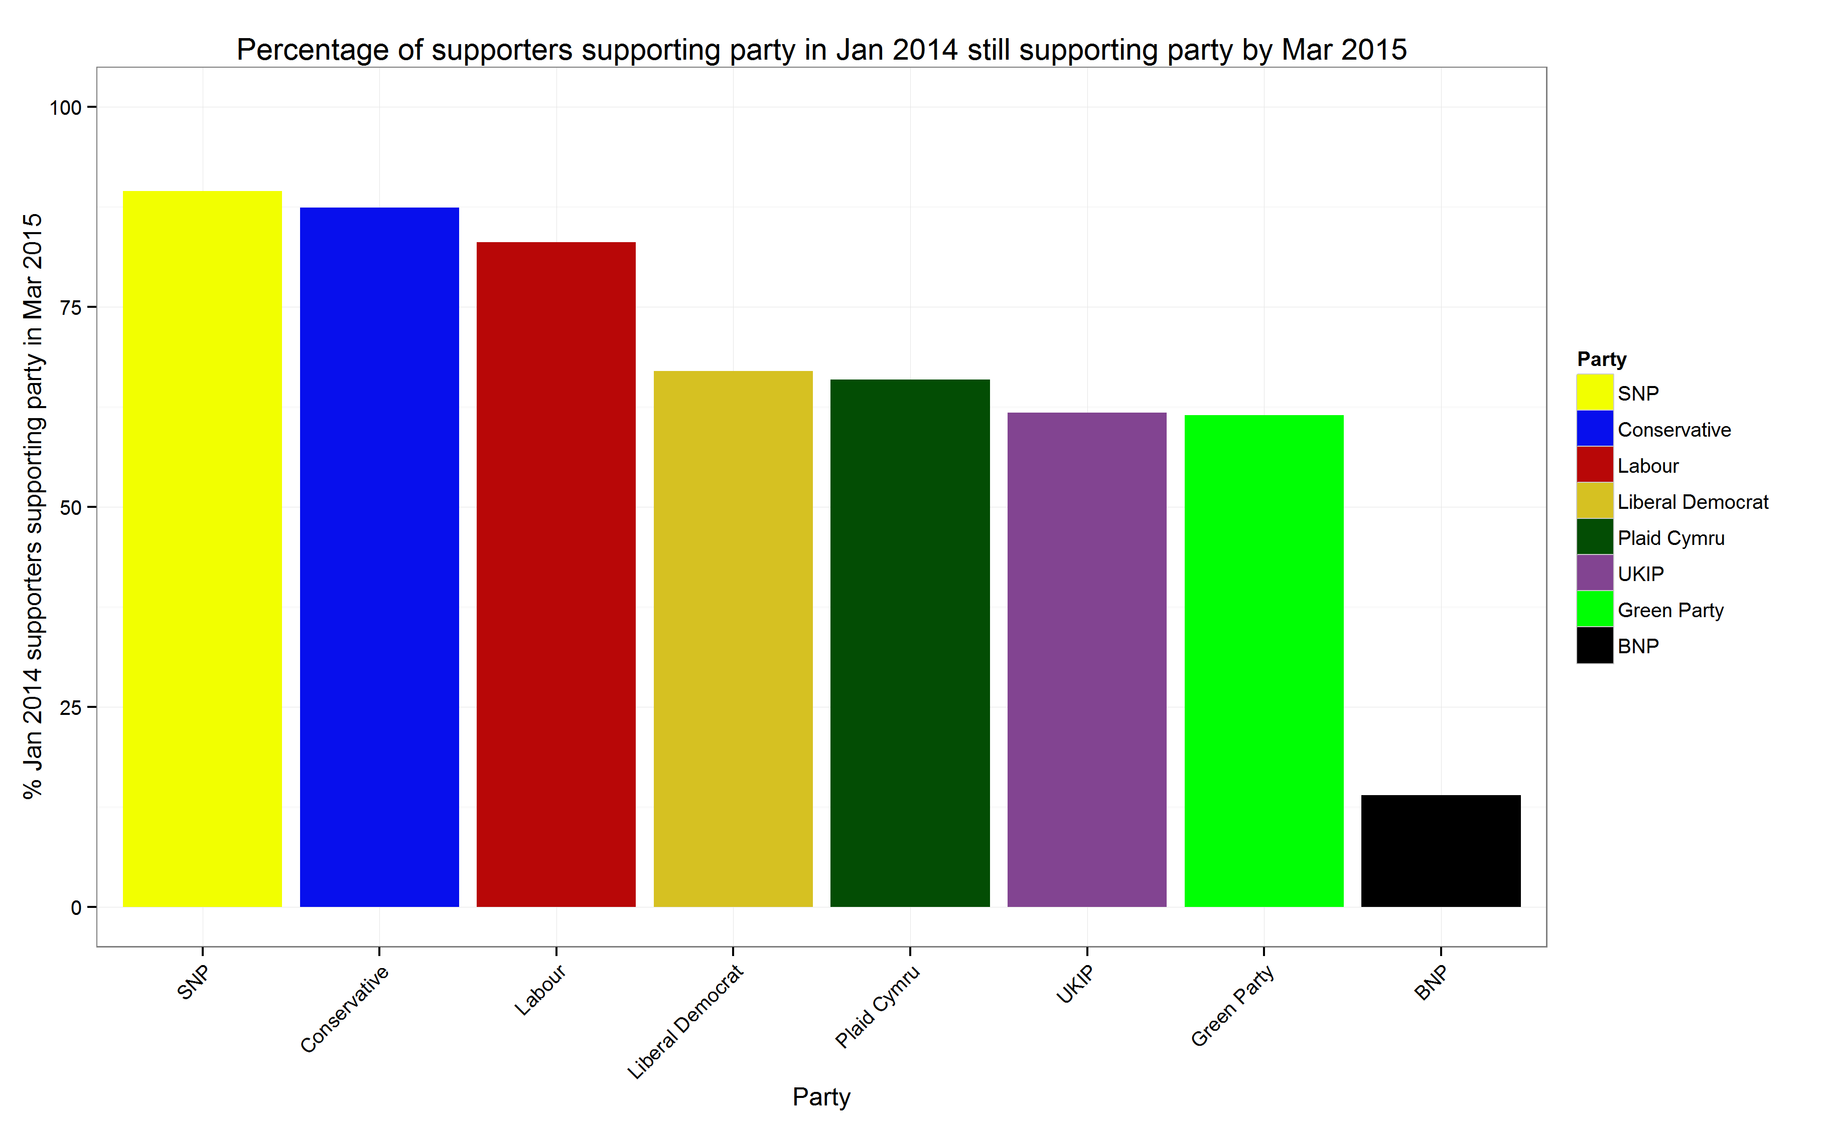
Voter retention over the long campaign
(between waves 1 and 4)

Slide 17
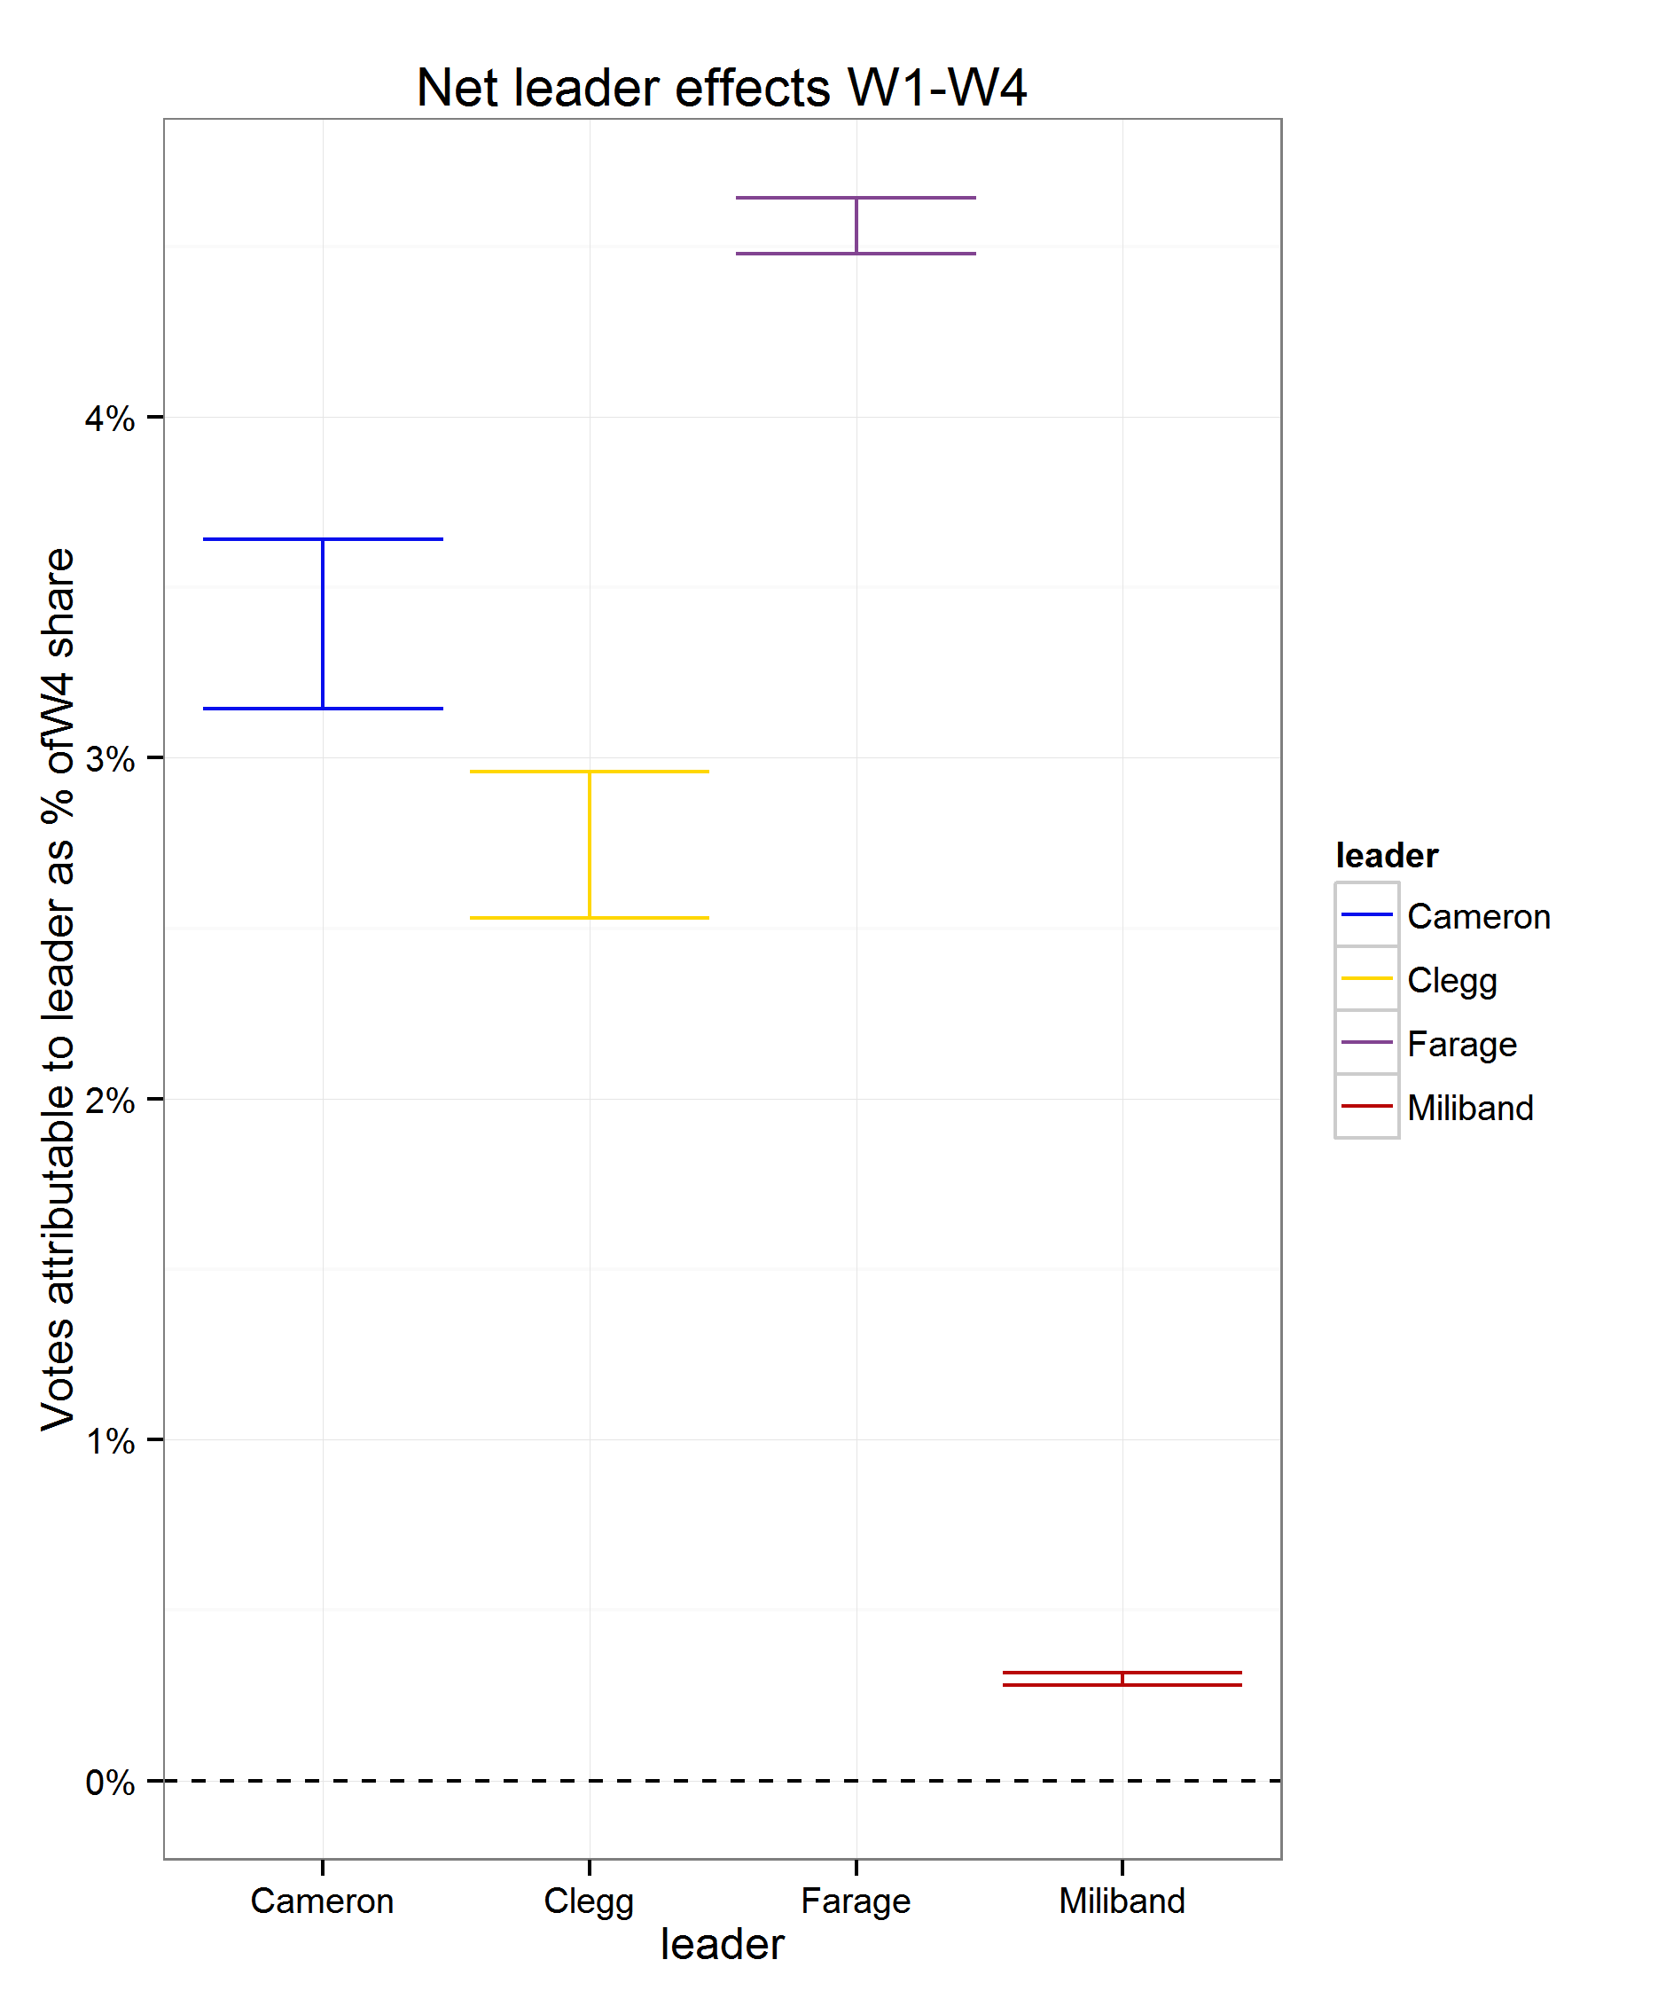
Leaders’ impact on vote switching Feb 2014 to Feb 2015
Notes:
Note that the wide band on the loss effects for Cameron is partly because the Conservatives didn’t lose many votes across that period (they retained 88% of their w1 voters). 5% of 12% of 27% is not that many votes.

Slide 18
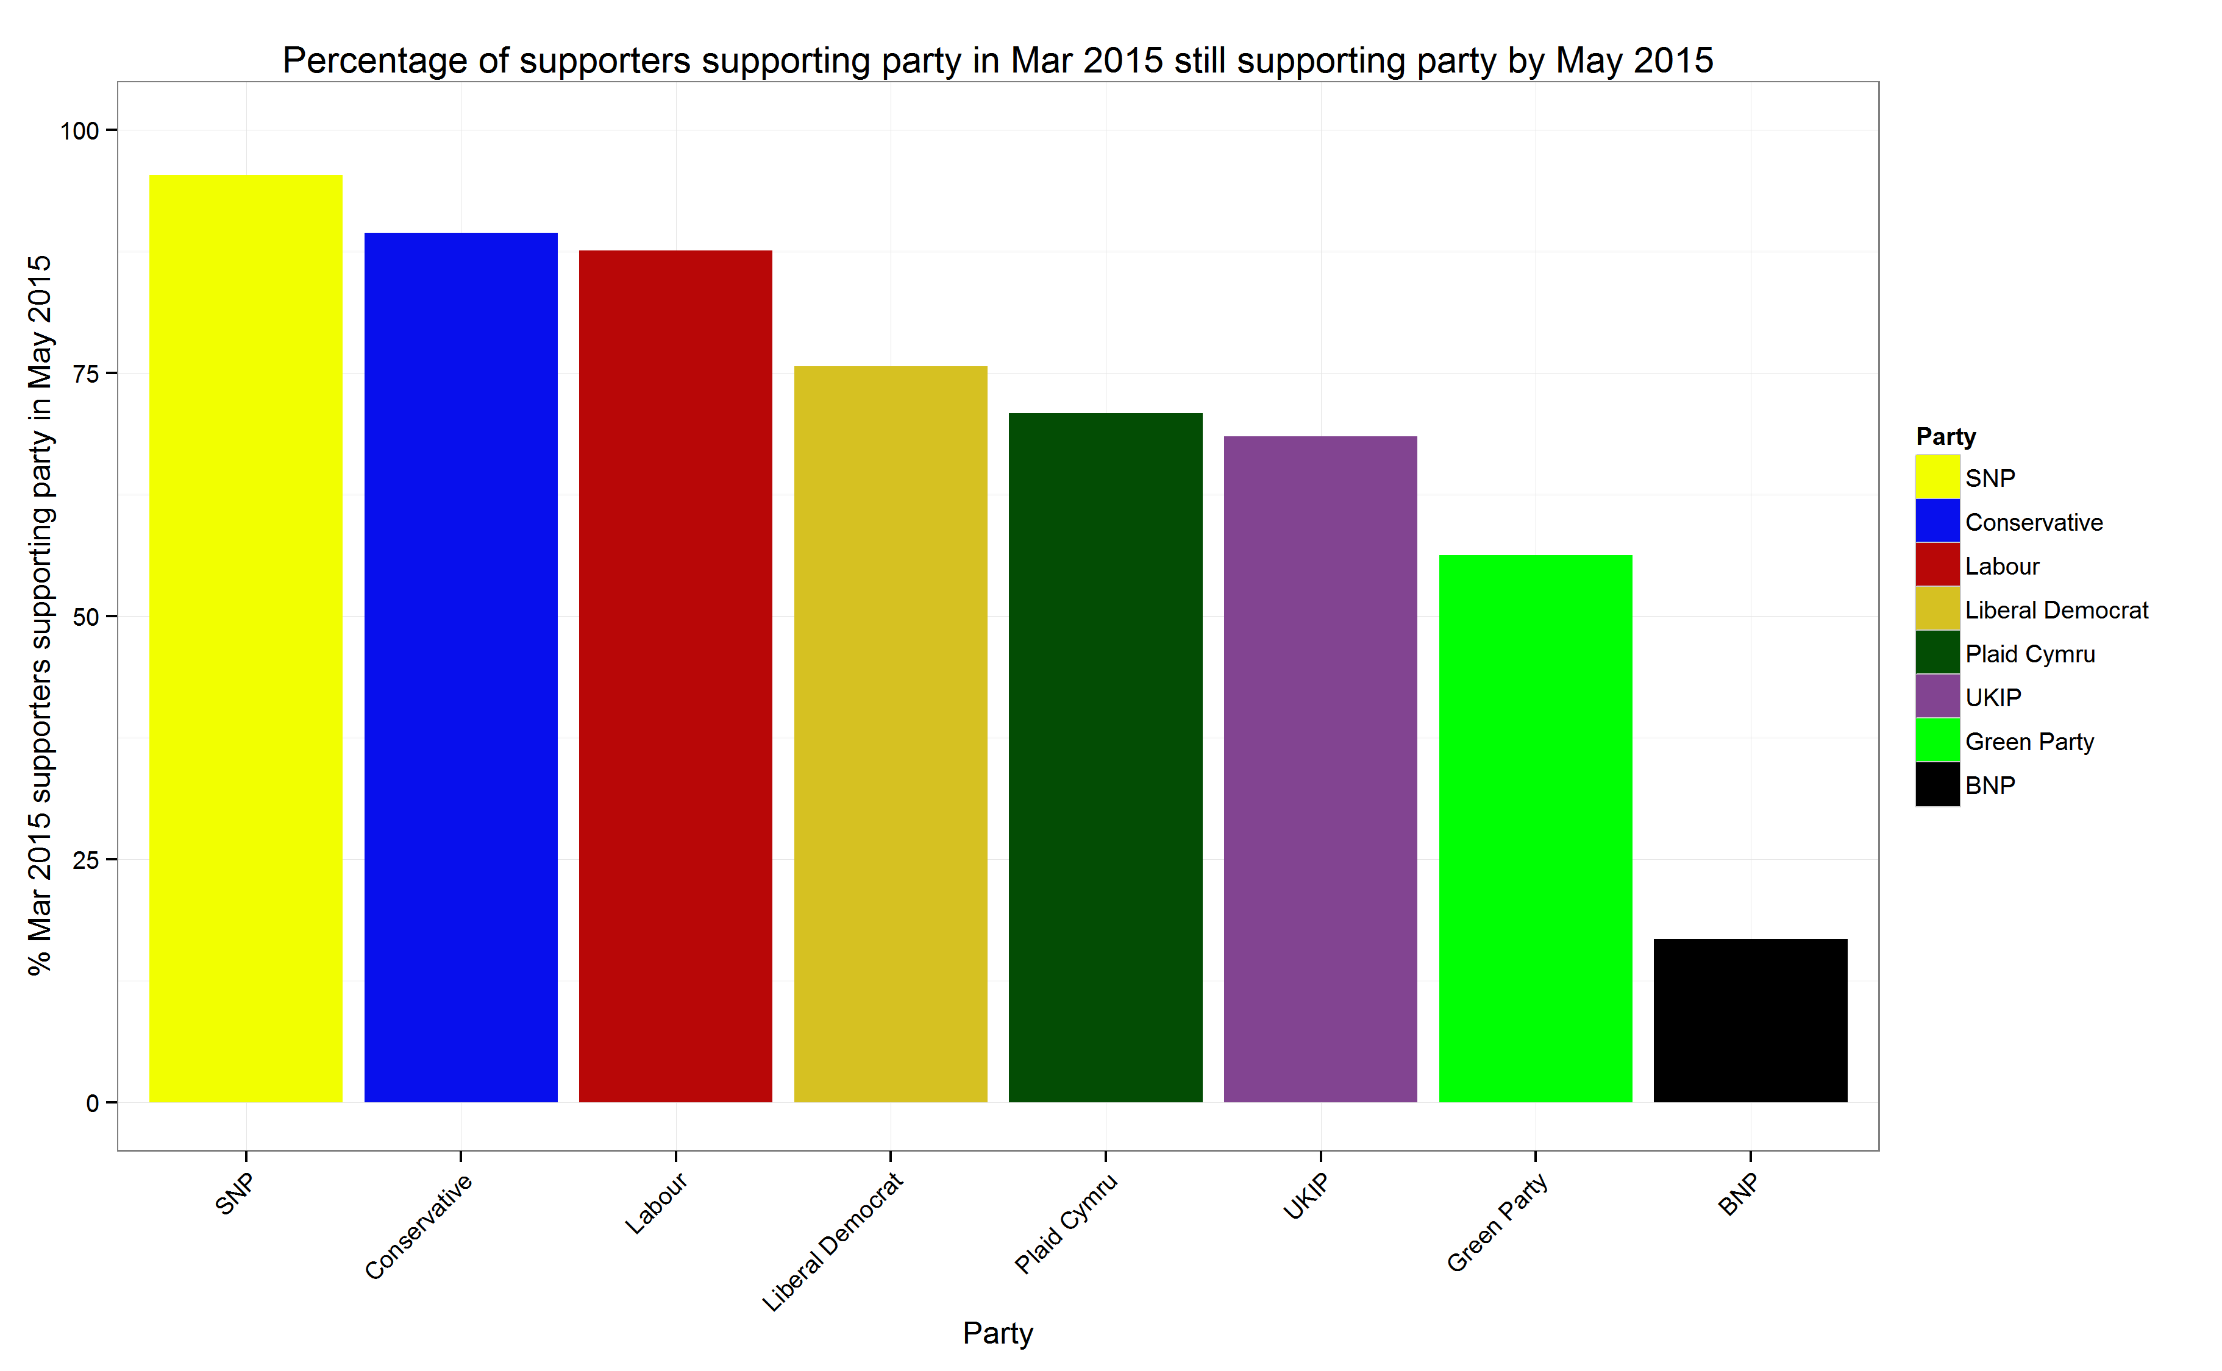
Voter retention over the formal campaign
(between waves 4 and 6)

Slide 19
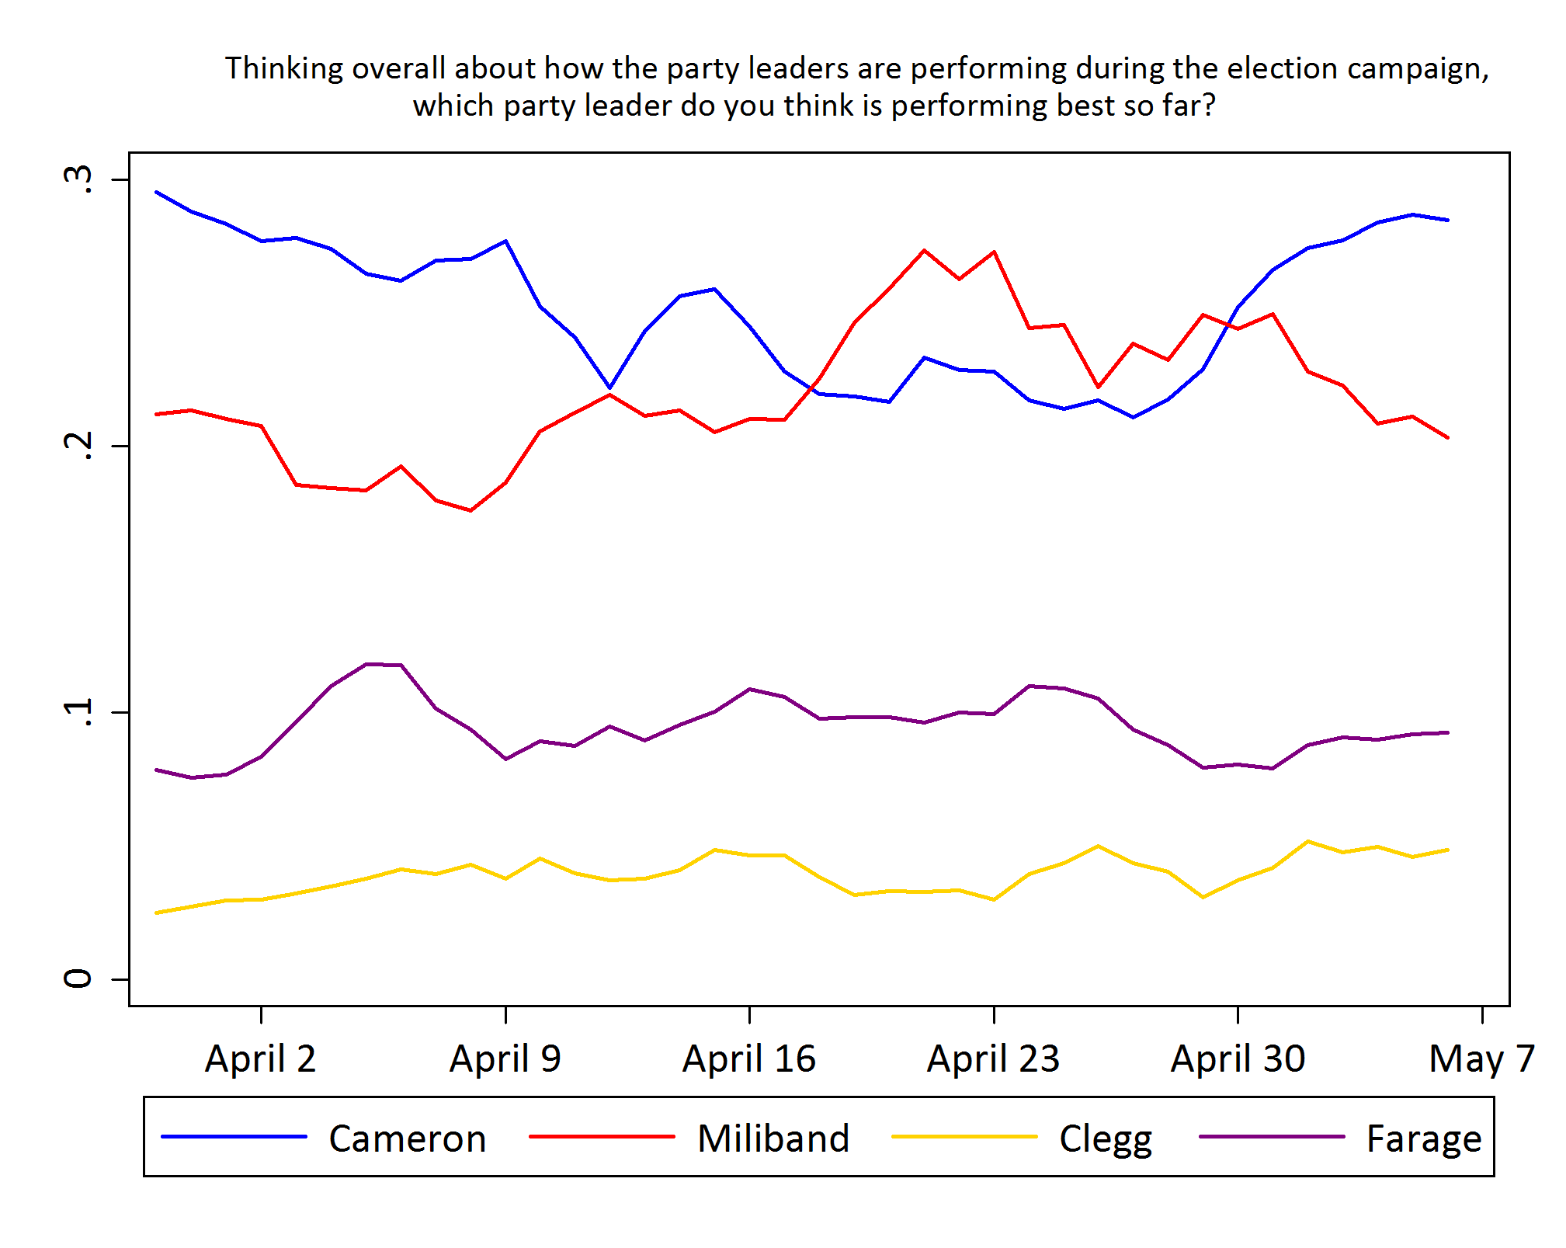
The campaign: how did the leaders fare?

Slide 20
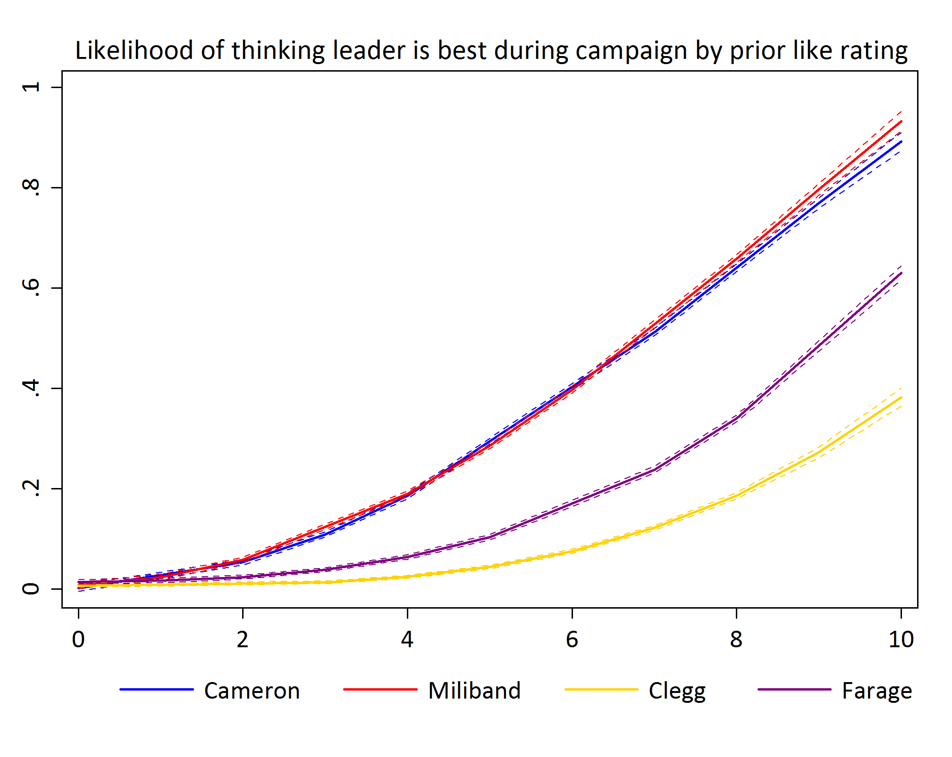
But judgements heavily influenced by prior beliefs

Slide 21
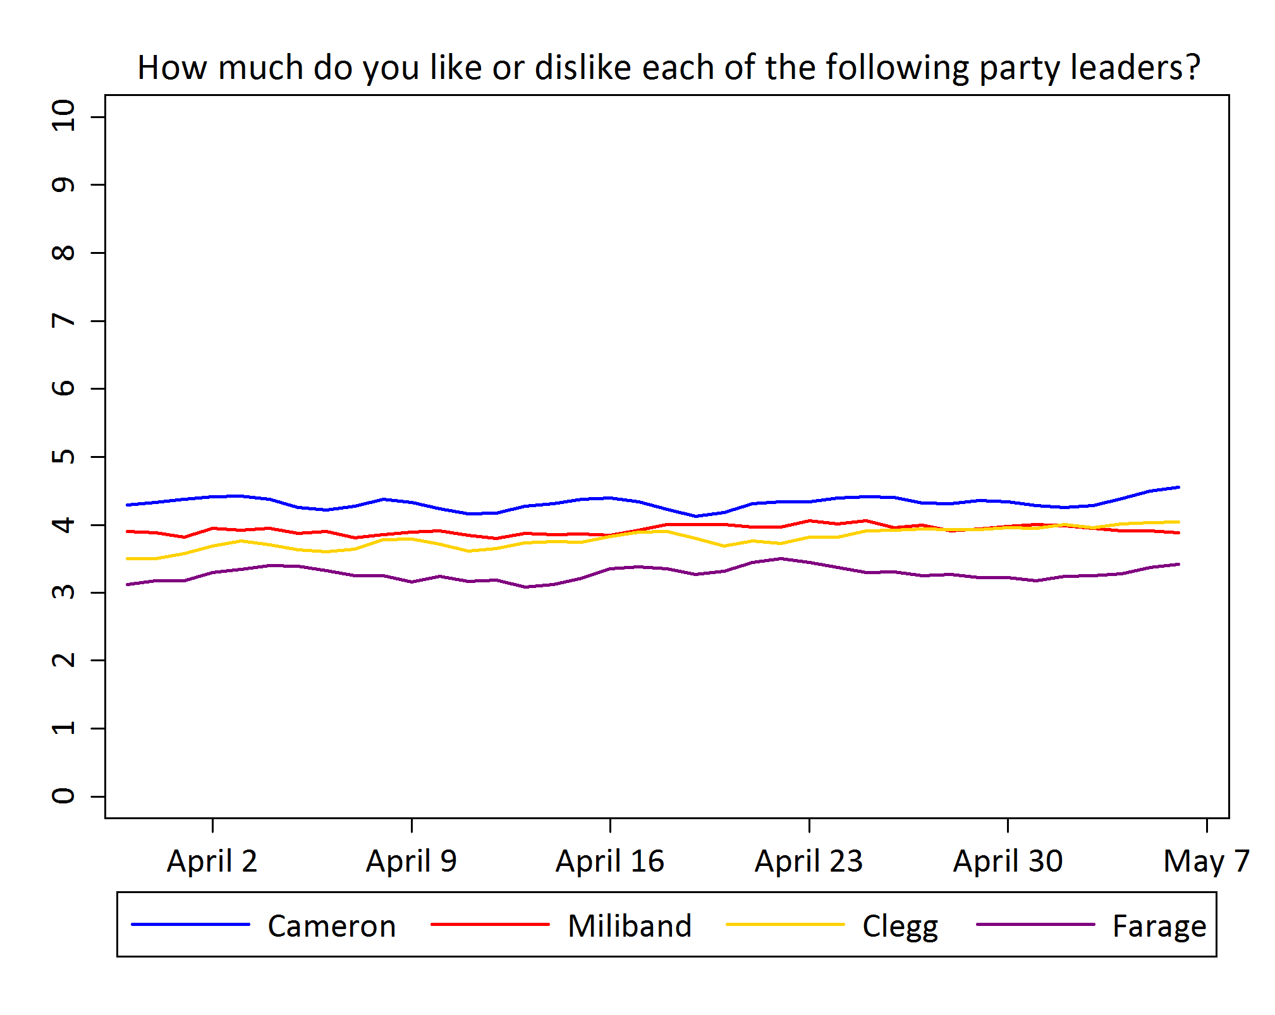
The campaign’s impact on leaders’ evaluations: nothing happened
(3-day moving averages)

Slide 22
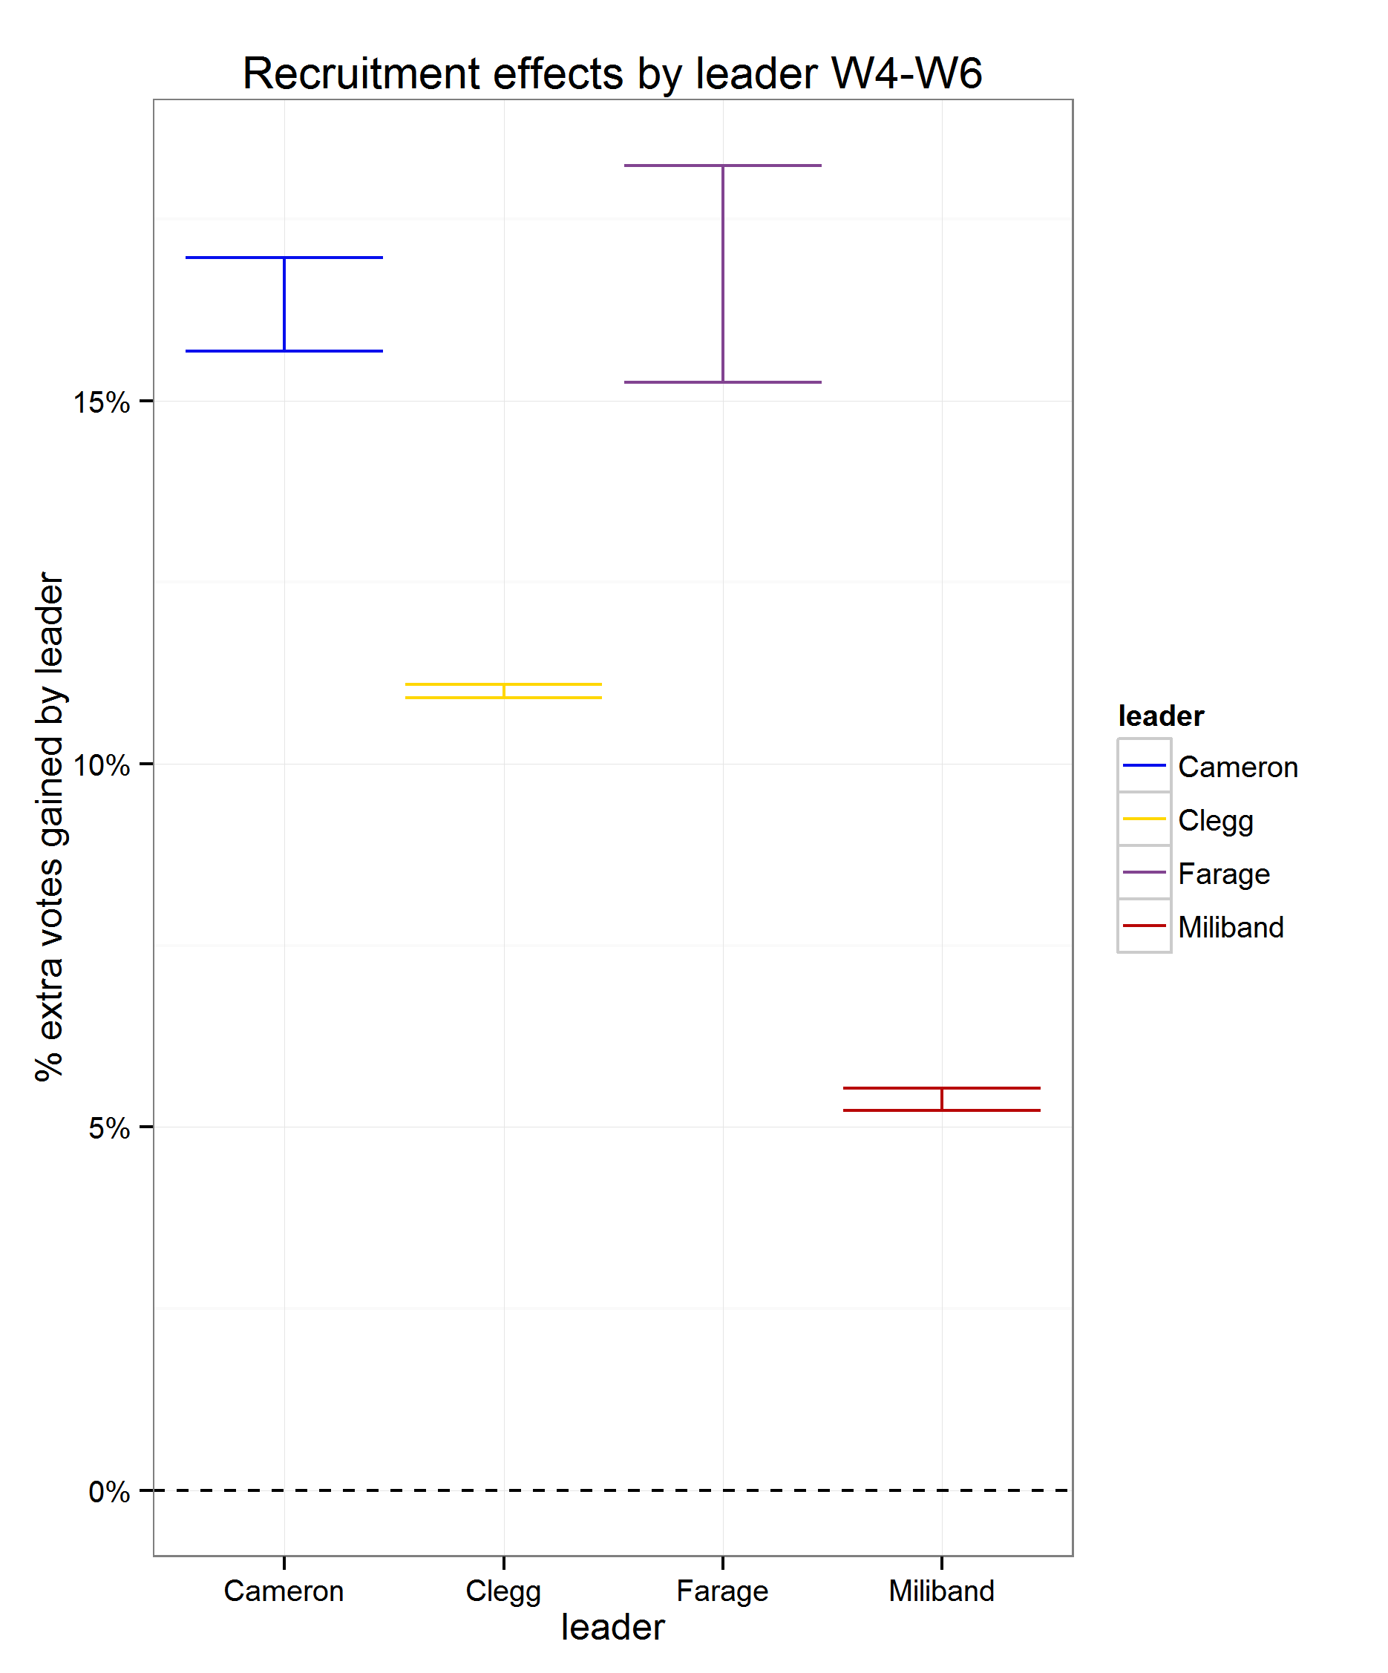
Leaders’ impact on recruitment from March to election day
Notes:
Doesn’t include issue controls

Slide 23
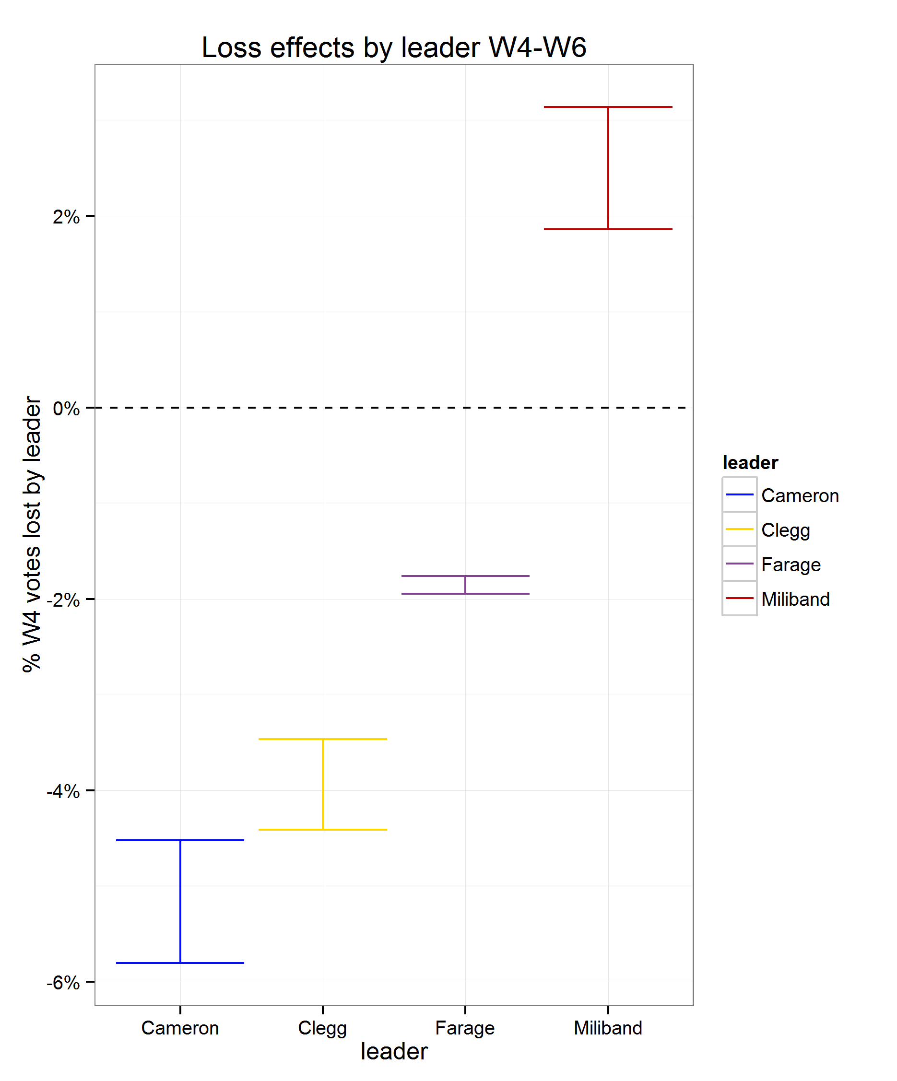
Leaders’ impact on vote switching from March to election day
Notes:
Doesn’t include issue controls

Slide 24
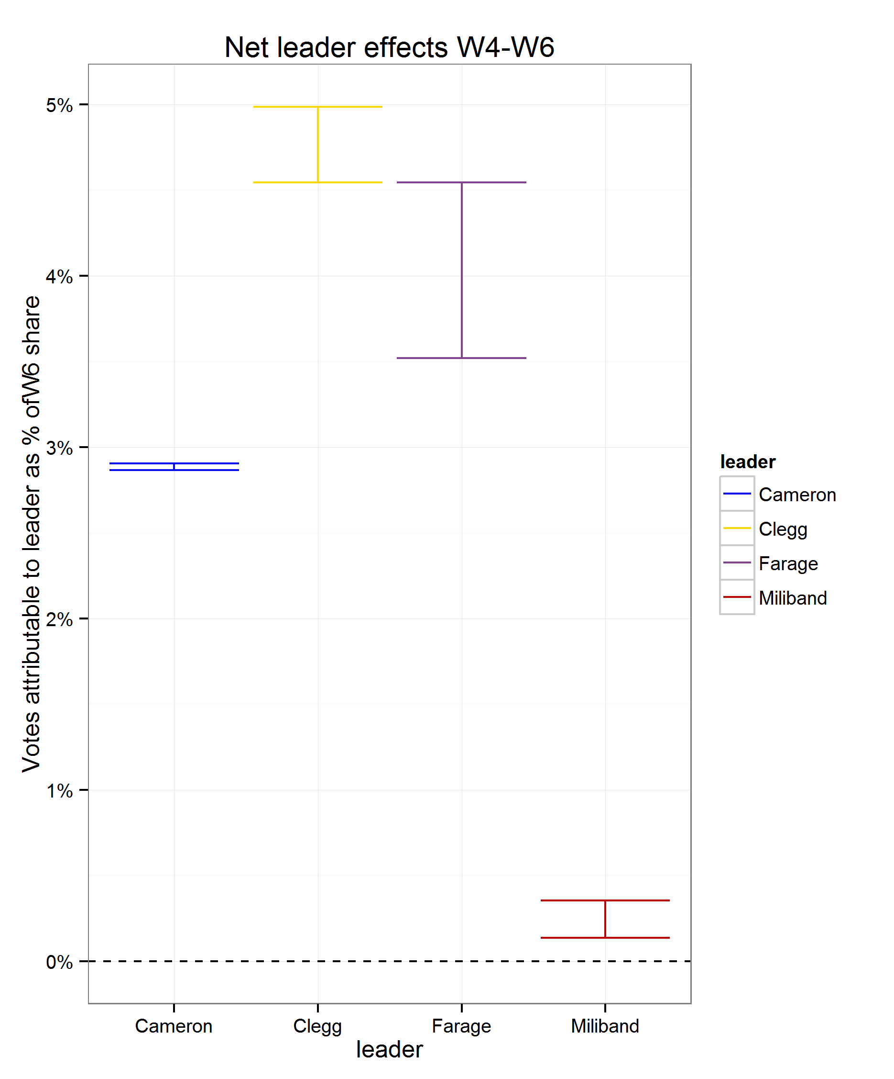
Leaders’ impact on vote switching from March to election day
Notes:
Doesn’t include issue controls

Slide 25
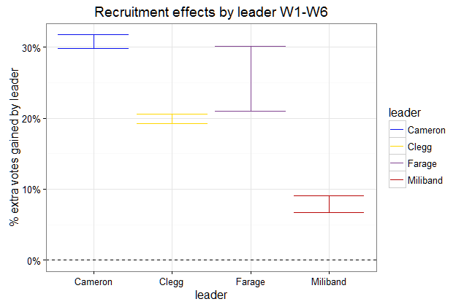
Recruitment effects of leaders Feb 14-June 15

Slide 26
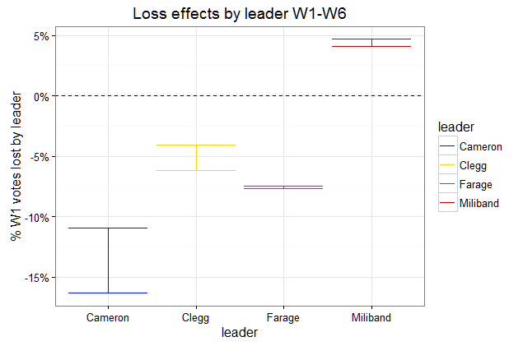
Loss effects of leaders Feb 14-June 15

Slide 27
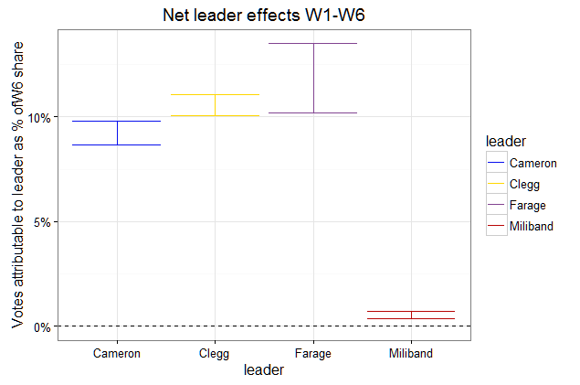
Overall effects of leaders Feb 14-June 15

Slide 28
Estimated leaders’ impact: Feb 2014 > election
Pull:
19-21% of UKIP gains can be attributed to changes in Farage's ratings
30-31% of Conservative vote gains can be attributed to changes in Cameron's ratings
7-9% of Labour gains can be attributed to changes in Miliband's ratings
19-21% of Lib Dem gains can be attributed to changes in Clegg’s ratings
Push:
4-5% of Labour losses can be attributed to changes in Miliband's ratings
UKIP would have lost 8% more votes if no one had changed their view of Farage.
The Conservatives would have lost 11-16% more votes if no one had changed their view of Cameron
The Lib Dems would have lost 4-6% more votes if no one had changed their view of Clegg

Slide 29
So how did they fare?
Farage: Importance of charismatic leadership for emerging parties
  UKIP increased their support in 2014 and maintained it in 2015 to a fair degree because of him
  Support for UKIP is flimsier than the main parties, with many voters switching away from UKIP regardless of Farage’s appeal
  Farage has to continue to out-perform other party leaders
David Cameron, qualified good news. Moderately effective in winning votes: A modest asset
Nick Clegg not toxic, even seems to have helped towards the end
Ed Miliband hindered Labour by not performing the usual role of a party leader bringing in votes

Slide 30
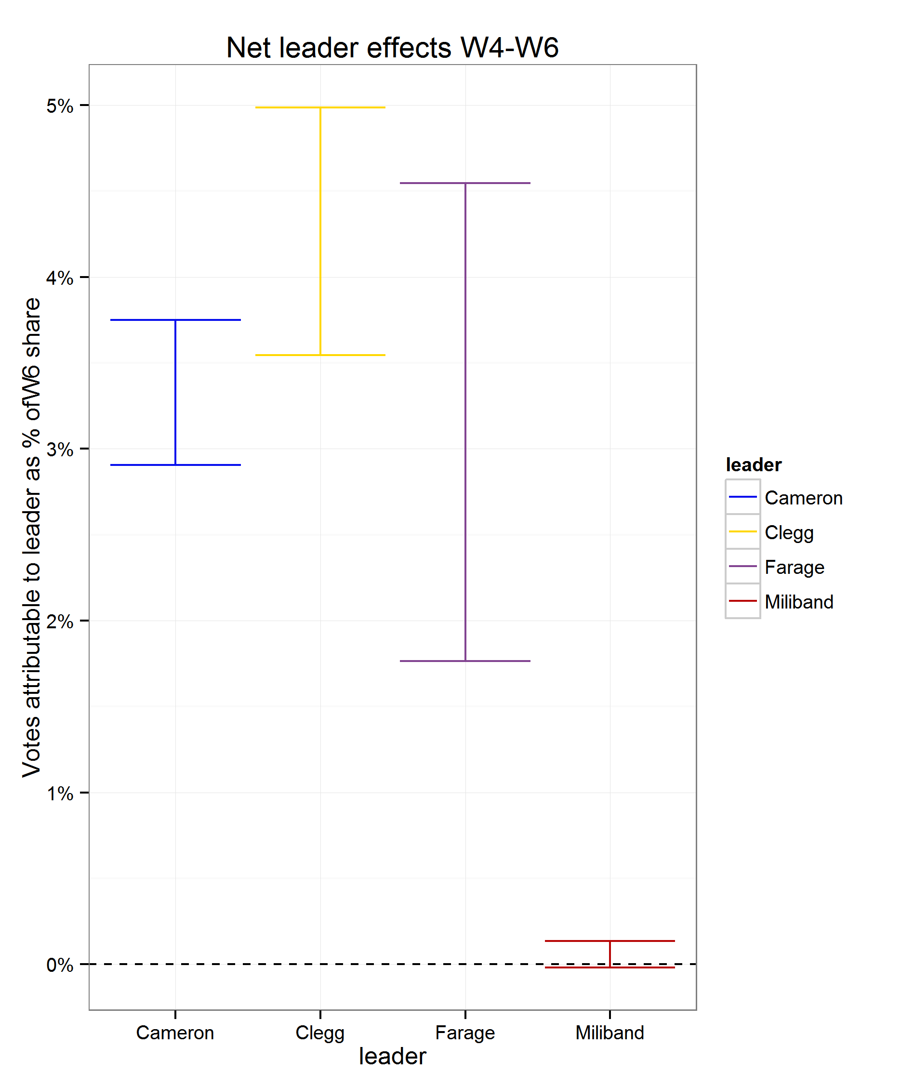
Leaders or party positions?
Net effects of leaders controlling for perceived party positions on redistribution & the EU
Excluding party positions
Including party positions

Slide 31
Estimation:

Slide 32
The remarkable stability of leader evaluations
Leader like correlations
Leader | W1 to W4 | W4 to W6 | W1 to W6
Cameron | 0.85 | 0.88 | 0.83
Miliband | 0.80 | 0.81 | 0.75
Clegg | 0.73 | 0.73 | 0.65
Farage | 0.71 | 0.82 | 0.68

Slide 33
Among vote switchers between waves 4 and 6:
  Those who moved to UKIP had far higher ratings of Farage in Wave 6 than Wave 4. Those who left were only slightly less positive
  This same pattern held for the Conservatives and Cameron
  Miliband’s ratings dropped moderately among those who left Labour, and increased moderately among those who moved to them
  Clegg’s approval changes were substantial among his (few) recruits but also a small positive change among defectors

Slide 34
The evidence base
Waves 1 – 6 of the BES panel survey, February 2014 – May/ June2015, N=c.22,000 respondents*
“How much do you like or dislike each of the following party leaders?” (response: 0 – 10 scale)
“Thinking overall about how the party leaders are performing during the election campaign, which party leader do you think is performing best so far?” (response: choose one)
*Not including Scotland

